Slide 1

New Features and Design Principles of Nacos 1.0.0
Pengfei Zhu (Github ID: nkorange) | 1st Meetup of Nacos at Hangzhou, Zhejiang | 13 Apr 2019

Slide 2
Contents
The New Nacos 1.0.0
The Design Principles
of Nacos Naming
The Coming Features

Slide 3


Part I
The New Nacos 1.0.0

Slide 4
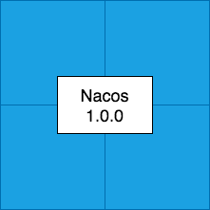
A global view of Nacos 1.0.0
Data warm up
Server status control
Stress test for large scale services
Symbiosis of AP and CP
Architecture
Production
Complete list of API
Insight of architecture
Benchmark results
Ephemeral instance
Service group name
MySQL 8.0 driver support
Documentation
Feature

Slide 5






Support ephemeral property of instance
Instance can be expired
Client sends beat to keep itself alive
Instance stays when unhealthy
Server side health check of instance
ephemeral=true
ephemeral=false
Instance of service

Slide 6




Stress test results released
High Capacity
High Scalability
1000,000 instances
1000,000 configurations
1000,000 clients
Extend to over 100 nodes
High Concurrency
Low Latency
Write TPS over 10,000
Read QPS over 10,000
99.9% of 10,000 clients receive push in 3 seconds
Complete reports available:
https://nacos.io/en-us/docs/nacos-config-benchmark.html
https://nacos.io/en-us/docs/nacos-naming-benchmark.html

Slide 7
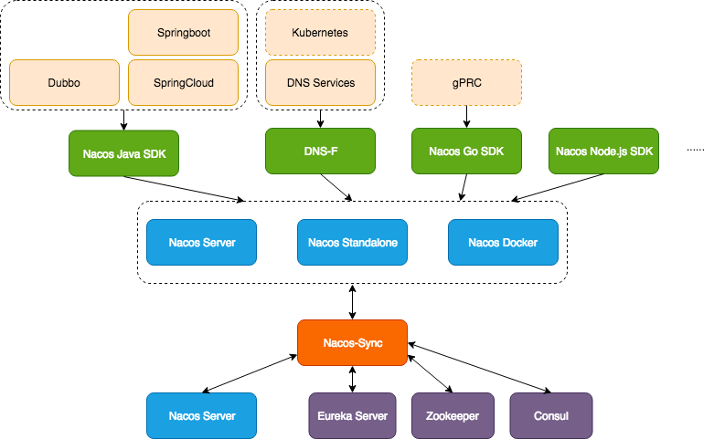
One registry center for all

Slide 8
Upgrade to Nacos 1.0.0
Nacos Server
under 0.8.0
Nacos Server 0.8.0
Nacos Server 1.0.0
Server under 0.8.0 upgrade to Server 0.8.0 first
Server 0.8.0 replace nacos-server.jar to Server 1.0.0
Client compatible to 0.5.0
Nacos Client since 0.5.0

Slide 9
Part II
The Design Principles of Nacos Naming

Slide 10
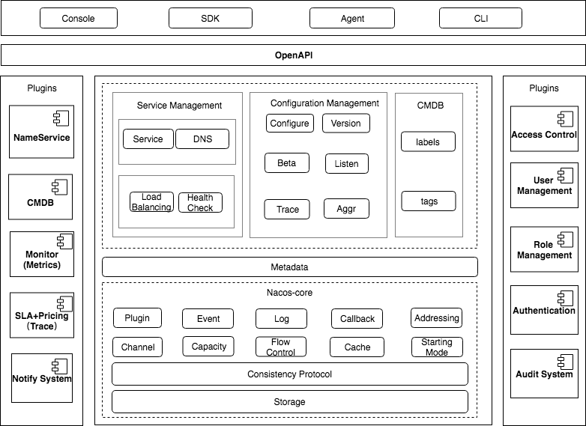
Modules of Nacos

Slide 11
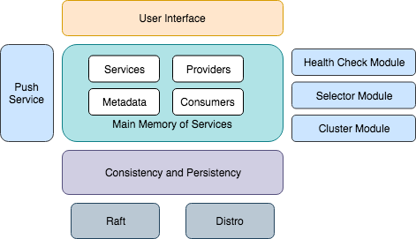
Architecture of Naming

Slide 12
Data model of Naming
Health Check Switch
Metadata
Selector
Protect Threshold
Company
Service
Health Check Mode
Metadata
Namespace
Sync Mode
Cluster
IP
Port
Group
Cluster
Instance
Weight
Health Status
Online/ offline
Service
Metadata
TTL
Instance
Instance
Instance
Four levels of data isolation between services
Three levels of data customization inside a service

Slide 13
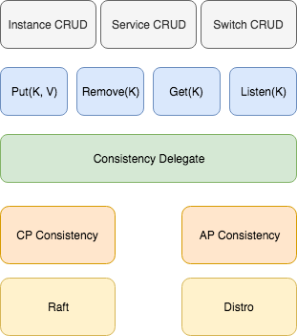
AP and CP work together
Bussiness CRUD does not feel consistency type
Abstracted datum CRUD
Use a delegate to determine which way to go
Two paths to choose: CP and AP
Raft acting as CP, Distro acting as AP

Slide 14
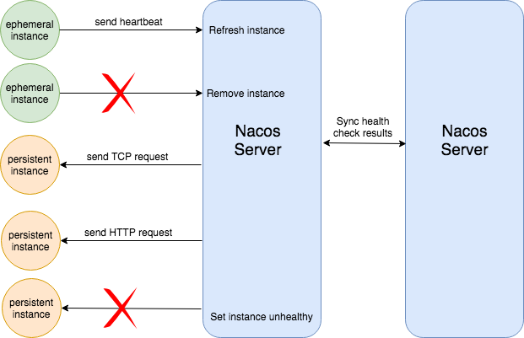
Health check of Nacos Naming
Ephemeral instance has to send
hearbeat to keep itself alive
Persistent instance can choose
its health check request type:
TCP, HTTP, MySQL or None
One server for one instance
Health check results are shared
between Nacos servers

Slide 15
Load balancing strategies in Nacos
Basic elements for load balancing
  Health Status: unhealthy instances are in principle excluded for consumers
  Online Status: offline instances are excluded for consumers
  Weight: a way to differentiate the propotion of request flows (not used by Dubbo and Spring Cloud Alibaba now)
Advanced elements for load balancing
  Selector: select instances with customized strategies
    Use label of instance to define the rule like: CONSUMER.label.site = PROVIDER.label.site
    More selectors are coming.

Slide 16
Part III
The Coming Features

Slide 17
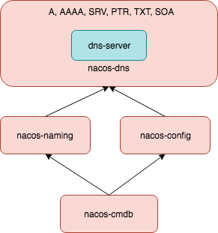
Server side DNS resolution
Why support DNS?
  Popular and easy to understand
  Libraries supported by every operation system and programming language
  DNS provides extensive types of data for service discovery
  Server side DNS for high availability and easier upgradation
  At least supports A, SRV, TXT, PTR
  Service data from nacos-naming
  System configuration from nacos-config
  Labels and metadata from nacos-cmdb

Slide 18
Address server mode
NacosFactory.createNacosInstance(Endpoint)
Nacos Client
Address Server
Nacos Server Cluster
Nacos Server Cluster
  Request address server to get Nacos server list
  Enable dynamic switch of Nacos server cluster by internally refreshing the server list from address server
  Different server list for different clients

Slide 19
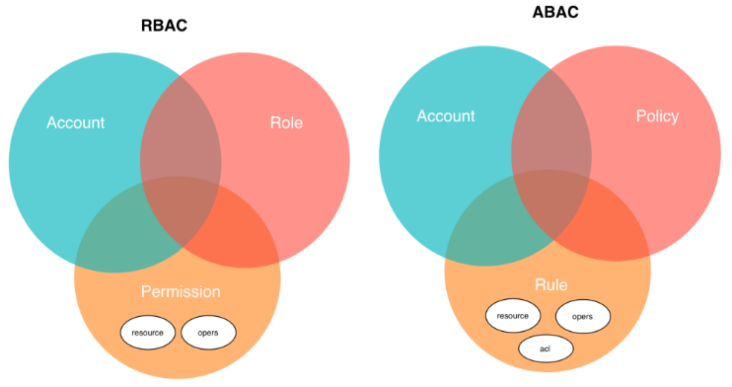
Full access control of resource
  Enable secure access of resource
  Contain a built-in light-weighted implementation
  Open integration for different auth systems

Slide 20
Extensive plugin integration
What we provide are never enough
A better way to extend and develop new features
Expecting plugin support for:
Health check
Load balancing
Notify system
Storage system
Message channel
…...
Plugin is optional
Plugin can be chained

Slide 21
Test framework of Nacos
A more comprehensive test engine for Nacos
Automatically deploys Nacos cluster
Continously writes to and read from Nacos cluster, records and reports errors
Introduces cluster failure to test the high availability of Nacos
Open source for user running and contribution
Open for good ideas!

Slide 22
Thank You !

